Slide 1
Agile
2021

Slide 2
Task 3: Role Assignments and Ceremonies

Slide 3
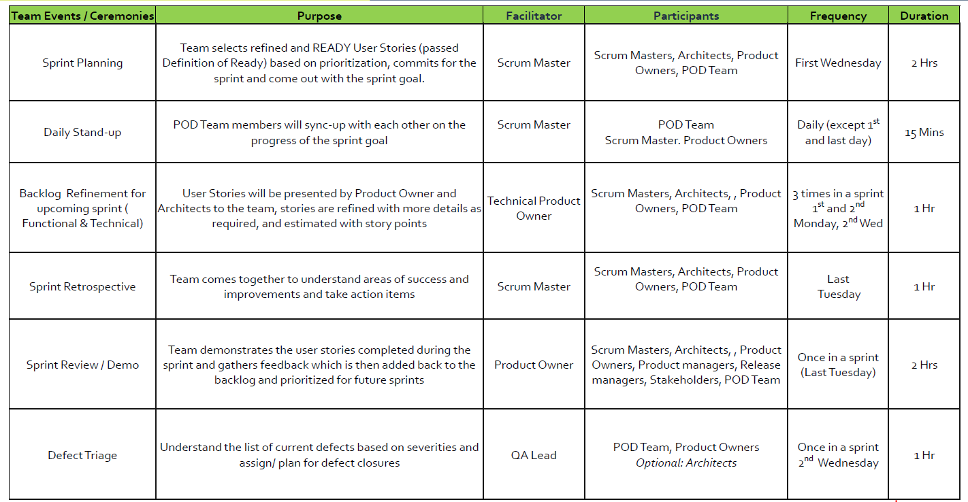
Sprint Ceremonies Cadence

Slide 4
Scrum -- Roles, Ceremonies and Artifacts
Roles
Product Owner
Scrum Master
Ceremonies
Sprint Planning
Sprint Review
Development Team
Sprint Retrospective
Daily Scrum
Artifacts
Product Backlog
Sprint Backlog
Burn Down Chart

Slide 5
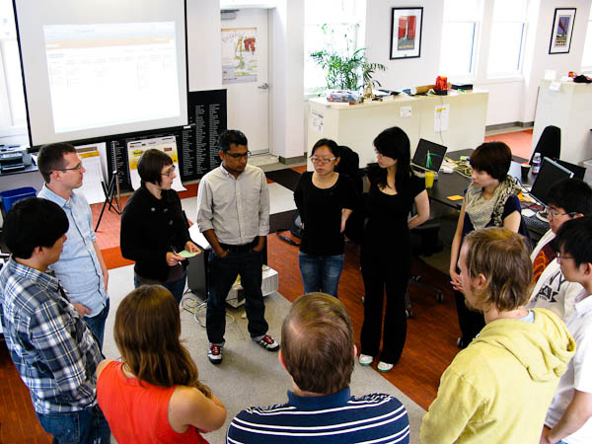
Daily Stand Up
Purpose: Inspect & Adapt event
the team inspects progress towards the sprint goal and adapts accordingly
Attendees: Scrum Team
Rules:
15 min time box
Everyone stands
Same time & place every day
Everyone answers three questions
What did you do yesterday?
What will you do today?
Is anything in your way?

Slide 6



Scrum Roles
Product Owner
The voice of the customer
Scrum Master
The Agile coach
Team
The ones who make it happen

Slide 7
Product Owner
Maximize the value of the Product backlog and work of the team
The PO is sole responsible person for managing the Product Backlog
The PO may be assisted by Technical POs to manage the Product Backlog, but PO remains accountable
Creating and clearly communicating Product Backlog items (Epics/Features/User Stories)
Prioritize Features and stories according to the market value
Accepts or rejects the work
Decides what is desired in a release after consulting all the stakeholders
Product Owner
The voice of the customer

Slide 8
Scrum Master
Is a Change Agent - Gathers support from everyone to make sure that change is accepted
Is a Coach – Train, mentor and make the team speak the same language
Is a Protector – Protects the team from the outside interferences
Is a Problem Solver – Works with stakeholders to escalate / resolve impediments so that the team achieve the sprint goal
Is a Process Owner – Teach Scrum to everyone and ensure that the right things are done the right way
Is a true leader who serve the Scrum Team and the larger organization
Scrum Master
The Agile coach
Notes:
Scrum Masters are true leaders who serve the Scrum Team and the larger organization
Scrum masters aren’t expected to be “Servant Leaders” as prescribed in earlier guides
Scrum master is now “accountable” for establishing scrum as prescribed by the Scrum guide.
Scrum master is accountable for effectiveness of the team
Scrum master has a responsibility of serving the organization in addition to the teams
Scrum master is no longer responsible for removing impediments but cause the removal of impediment for the dev team

Slide 9
The Team
A cross functional and self-managing team
Empowered and autonomous
Creating a plan for the Sprint, the Sprint Backlog;
Instilling quality by adhering to a Definition of Done;
Adapting their plan each day toward the Sprint Goal; and,
Holding each other accountable as professionals.
Team
The ones who make it happen
Notes:
Developers are the people in the Scrum Team that are committed to creating any aspect of a usable Increment each Sprint.
The specific skills needed by the Developers are often broad and will vary with the domain of work. However, the Developers are always accountable for:
● Creating a plan for the Sprint, the Sprint Backlog;
● Instilling quality by adhering to a Definition of Done;
● Adapting their plan each day toward the Sprint Goal; and,
● Holding each other accountable as professionals.

Slide 10
Activity - Responsibilities (5 minutes)
Skillsets | Value | Sprint Backlog
responsibility | Product Backlog | Individual
assigned | Team | Self-Manage
Teams should contain the necessary ________ needed to complete the items.
Story-level estimates are done by the __________.
Task-level estimates are done by the ___________.
Teams are not ___________ work, instead they accept _____________.
Teams are responsible for creating and maintaining the _____________.
Teams members can ask for clarification of items in the _____________.
Teams ___________ to complete items that have ____________.
Skillsets
Team
Individual
assigned
responsibility
Sprint Backlog
Product Backlog
Self-Manage
Value

Slide 11
Activity - Scrum Role & Responsibilities (5 Minutes)
Which Scrum role matches each responsibility?
Remove Impediments | Creates initial set of Acceptance Criteria | Estimates stories | Provides Technical Delivery alternatives
Commits to work for a given Sprint | Represent the business and customer | Answers questions on User Stories | Attends Backlog Refinement
Orders Product Backlog | Assigns stories and tasks for development | Owns the Product Backlog | Brings in Agile and scrum practices
Build the Sprint Backlog | Estimate Tasks | Provides a Shield from Distractions | Facilitates Scrum Meetings
Attends QI planning | Attends Sprint Planning | Attends Scrum of Scrums | Owns the delivery of Sprint commitments
Scrum Master
Product Owner
Team
Team
Team
Product Owner
Product Owner
Team
Product Owner
Team
Product Owner
Scrum Master
Team
Team
Scrum Master
Scrum Master
All
Team
Scrum Master
Team
Notes:
Add animations with answers

Slide 12
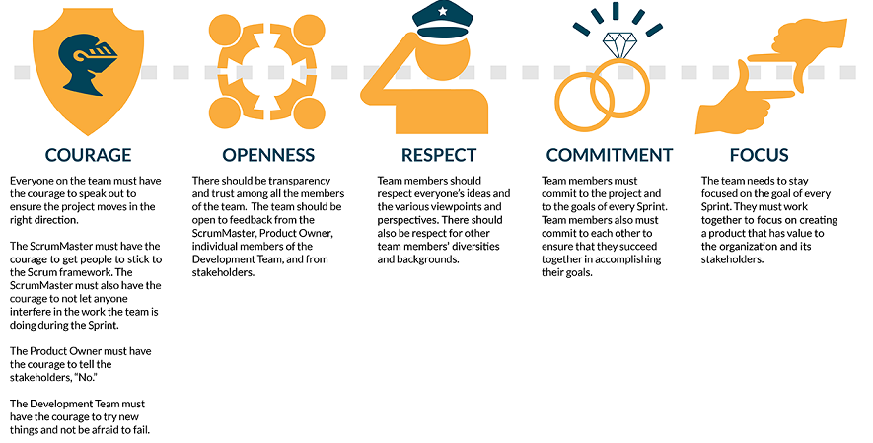
Scrum Values

Slide 13



















Scrum framework
Agile Coach
Daily Scrum
Scrum Master
24 hours
Sprint Review
The Team
1-4 weeks
Potentially Shippable
Product Increment
Product Backlog
Sprint Backlog
Release Cycle
Product Owner
Mike Cohn; Mountain Goat Software
Sprint Retrospective

Slide 14
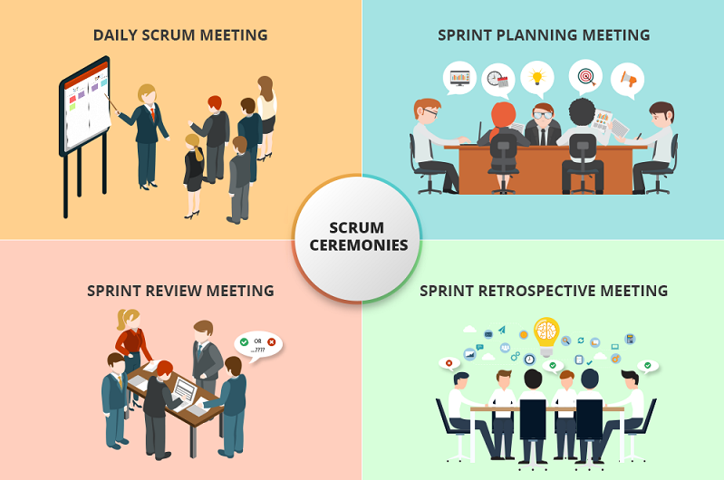
Scrum Events

